Slide 1


Introduction
Managing barangay resources has always been a task that takes time, patience, and a lot of manual work. From keeping track of supplies to logging borrowed items and making sure everything is returned properly it’s easy for things to get disorganized or forgotten, especially when everything is done on paper.
That’s why we developed the Barangay Inventory Management System to provide a smarter, more efficient way to manage barangay assets, materials, and equipment. Instead of relying on handwritten logs and paper return slips, this system moves everything into a digital platform that’s easy to use and always accessible.

Slide 2

Our
products
The system comes with features like Inventory Management, where each item is tracked whether it’s available, in use, or already borrowed. No more second-guessing or spending hours checking records. It also includes a Paperless Borrow and Return system that automatically updates item status in real time, so we don’t have to worry about losing slips or forgetting to log returns.
"Streamlining Resources, Empowering Barangay Management"

Slide 3
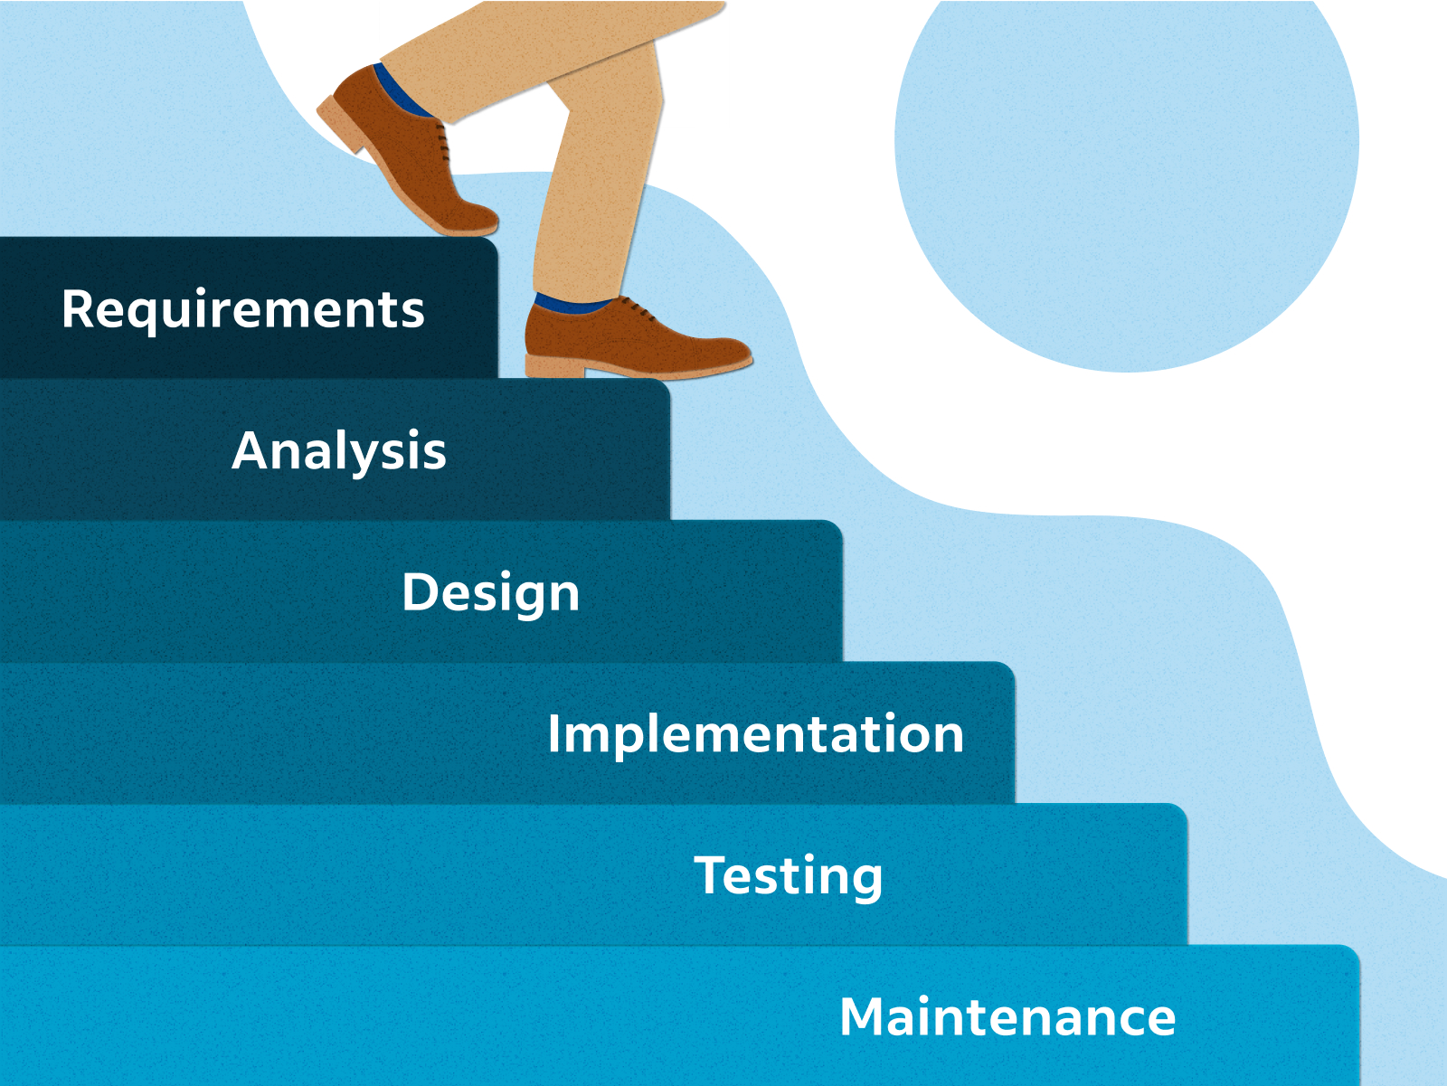
Development Approach
Technology Acceptance Model (TAM) The TAM explains how users (Barangay Staff) come to accept and use technology based on perceived usefulness and ease of use.
This reduces clutter and the time spent managing physical documentation. Instead of manually processing forms, barangay can focus on more important tasks.
Nuyda, D. M., Calma, J. R., Tampos, J. I., Leandres, C. K. M., & Arbutante, R. A. Z. (2012). Online Inventory and Monitoring System of Cagayan de Oro City Health Office. Advancing Information Technology Research, 3(1), 69-74.
Bautista, R. M. (2015). Promoting Digital Empowerment through Implementation of Barangay Management System. International Journal of Engineering Research and General Science, 3(2), 563-569.

Slide 4

With this system in place, barangay staff can focus more on serving the community instead of getting stuck with paperwork. It also promotes transparency and accountability, since every transaction is recorded and easy to review.
Overall, the goal is simple to help the barangay operate more smoothly, save time, and make sure resources are used properly and responsibly. This is a step towards modernizing our processes and making local governance more efficient for everyone.
Barangay Inventory Management System
A convenient and paperless system.

Slide 5




Team
Arnel C . Martin
Stephen John Salgado
Bernardo F. Unilongo l
Business Analyst
Project Manager
Lead Software Engineer

Slide 6

The End
Thank you for listening!

